Slide 1
Introduction to MySQL

Slide 2
Outline
Introduction to MySQL

Slide 3
Introduction to MySQL
MySQL is an open-source relational database management system.
MySQL is written in C and C++.
MySQL was created by a Swedish company, MySQL AB.
The first version of MySQL appeared on 23 May 1995.
Sun Microsystems acquired MySQL AB in 2008.
Oracle acquired Sun Microsystems on 27 January 2010.
Notes:
3

Slide 4
Introduction to MySQL
MySQL is a central component of the LAMP open-source web application software stack. LAMP is an acronym for "Linux, Apache, MySQL, Perl/PHP/Python".
MySQL is used in many high-profile, large-scale websites, including Facebook, Twitter, ebay, Spotify, Pinterest, YouTube, Uber, booking.com, Bank of America, etc. See more at: https://www.mysql.com/customers/
MySQL can be downloaded for free at: https://dev.mysql.com/downloads/installer/
Notes:
4

Slide 5
Introduction to MySQL Contd…
We will be using MySQl Workbench to write and run our queries.
See existing databases
show databases;
Create a database called university
create database university;
Connect to the university database
use university;
Notes:
5

Slide 6
Introduction to MySQL Contd…
Create an instructor table within the university database
create table instructor (
id int PRIMARY KEY,
name varchar(20),
dept_name varchar(20),
salary int
);
Notes:
6

Slide 7
Introduction to MySQL Contd…
You can also specify primary key at the end of the create statement.
create table instructor (
id int,
name varchar(20),
dept_name varchar(20),
salary int,
primary key (id)
);
Notes:
7

Slide 8
Introduction to MySQL Contd…
View tables in the university database
show tables;
View table description
desc instructor;
Notes:
8

Slide 9
Introduction to MySQL Contd…
Insert records into the instructor table
insert into instructor values(1001,'Tim Hamling','Computer Science',50000);
insert into instructor values(1002,’Amireer Baker’, 'Biology',40000);
insert into instructor values(1001,'Tina Tian','Computer Science',60000); //This gives an error!
insert into instructor values(1003,'Tina Tian','Computer Science Department',50000); //This gives an error!
Insert multiple records
insert into instructor values(1003,'Tina Tian','Computer Science',50000),(1004,'Kashifuddin Qazi','Computer Science',45000);
Notes:
9

Slide 10
Introduction to MySQL Contd…
Query the table to display all records
select * from instructor;
Delete a particular record from instructor
delete from instructor where id = 1004;
Delete all records from instructor
delete from instructor;
Delete table instructor
drop table instructor;
Delete university database
drop database university;
Notes:
10

Slide 11
The CHECK constraint
The CHECK constraint is used to limit the value range that can be placed in a column.
create table instructor (
id int PRIMARY KEY,
name varchar(20),
dept_name varchar(20),
salary int check (salary >= 50000)
);
Unfortunately, MySQL does not support CHECK constraint. Actually, MySQL accepts the CHECK clause in the CREATE TABLE statement but it ignores it silently.
You can use alternate methods such as triggers.
Notes:
11

Slide 12
NOT NULL constraint
What happens when you run the following insert statement?
insert into instructor (id, dept_name, salary) values(1001,'Computer Science',50000);
Notes:
12

Slide 13


NOT NULL constraint
What happens when you run the following insert statement?
insert into instructor (id, dept_name, salary) values(1001,'Computer Science',50000);
Since we are not providing a value for name, it is assigned a null value.
If you would like to avoid null values being assigned to a variable, use the NOT NULL constraint in the create statement.
Notes:
13

Slide 14
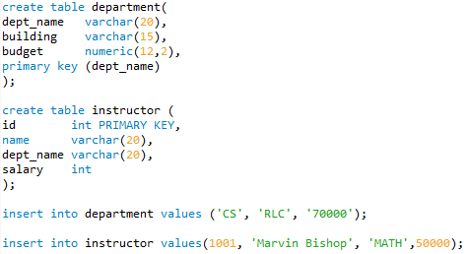
Foreign Key constraint
A foreign key is a field (or fields) that points to the primary key of another table.
The purpose of the foreign key is to ensure referential integrity of the data. In other words, only values that are supposed to appear in the database are permitted.
Consider the following two tables and the two insert statements.
Will the instructor data be inserted?
Should the instructor data be inserted?
Notes:
14

Slide 15
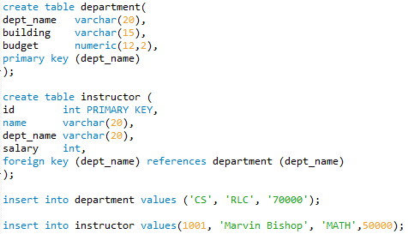
Foreign Key constraint
The instructor data should not be inserted because the MATH department does not exist.
We can avoid such situations by using foreign key constraints.
In this case we make dept_name in instructor the foreign key of dept_name in department using the foreign key constraint.
Notes:
15

Slide 16
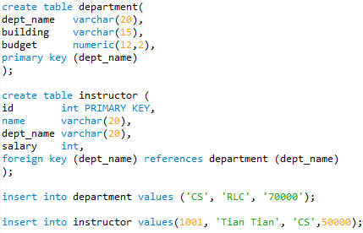
Foreign Key constraint – On Delete
Consider the following two tables and the two insert statements:
What happens when you run the following delete statement?
Notes:
16

Slide 17
Foreign Key constraint – On Delete
You are not able to delete because of the foreign key constraint.
Let’s say, the CS department is being discontinued and should be deleted from the department table.
What should we do with the instructor tuple? What are the possible options?
Notes:
17

Slide 18
Foreign Key constraint – On Delete
You are not able to delete because of the foreign key constraint.
Let’s say, the CS department is being discontinued and should be deleted from the department table.
What should we do with the instructor tuple? What are the possible options?
Well, you could delete the instructor tuple when the corresponding department is removed.
Or, you can retain the instructor tuple and set her department to null.
Notes:
18

Slide 19
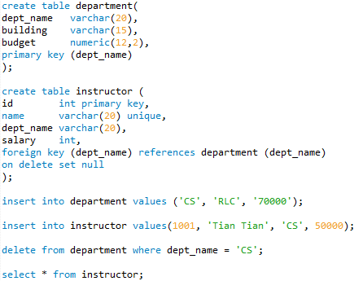
Foreign Key constraint – On Delete
The following will set department to null for the instructor.
Notes:
19

Slide 20
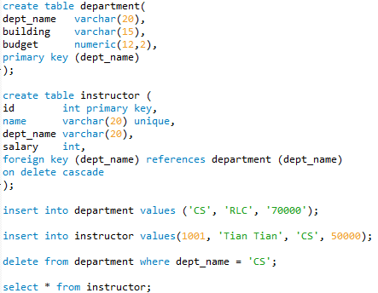
Foreign Key constraint – On Delete
The following will delete the instructor record affiliated with CS department.
Notes:
20

Slide 21
DEFAULT Values
A DEFAULT value clause in a data type specification explicitly indicates a default value for a column.
create table instructor (
id int PRIMARY KEY,
name varchar(20),
dept_name varchar(20) default 'CS’,
salary int
);
The following insert statement will add CS as the department name by default.
insert into instructor(id, name, salary) values(1001, 'Tian Tian', 50000);
Notes:
21

Slide 22
UNIQUE Constraint
The UNIQUE constraint ensures that all values in a column are different.
A PRIMARY KEY constraint automatically has a UNIQUE constraint.
However, you can have many UNIQUE constraints per table, but only one PRIMARY KEY constraint per table.
Also, PRIMARY KEY does not allow nulls, where as UNIQUE key allows one null.
Notes:
22

Slide 23
UNIQUE Constraint
create table instructor (
id int PRIMARY KEY,
name varchar(20) unique,
dept_name varchar(20),
salary int
);
The second insert statement will give an error.
insert into instructor values(1001, 'Tian Tian', 'CS', 50000);
insert into instructor values(1002, 'Tian Tian’, ‘IT’, 95000);
Notes:
23

Slide 24
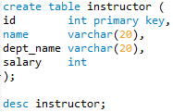
ALTER Command
The MySQL ALTER command is very useful when you want to change a name of your table, any table field or if you want to add or delete an existing column in a table.
Consider the following table:
If we need to drop the name column, use the following command:
alter table instructor drop name;
desc instructor;
To add a column, use the following command:
alter table instructor add name varchar(20);
desc instructor;
Note that the new column “name” above is added to the end of the table.
Notes:
24

Slide 25
ALTER Command
To indicate that you want a column at a specific position within the table, either use FIRST to make it the first column or AFTER col_name to indicate that the new column should be placed after the col_name.
The following adds the name column as the first column within the table.
alter table instructor add name varchar(20) first;
desc instructor;
The following adds the name column after the id column.
alter table instructor add name varchar(20) after id;
desc instructor;
Notes:
25

Slide 26
ALTER Command
To change a column's definition, use MODIFY or CHANGE clause along with the ALTER command.
alter table instructor modify name varchar(30);
desc instructor;
If you use the CHANGE command, you also need to specify the new column name. Here, I change “name” to “fullname”.
alter table instructor change name fullname varchar(40);
desc instructor;
Notes:
26

Slide 27
ALTER Command
To rename a table, use the RENAME option of the ALTER TABLE statement.
alter table instructor rename faculty;
show tables;
You can also rename a table as follows:
rename table instructor to faculty;
Notes:
27

Slide 28
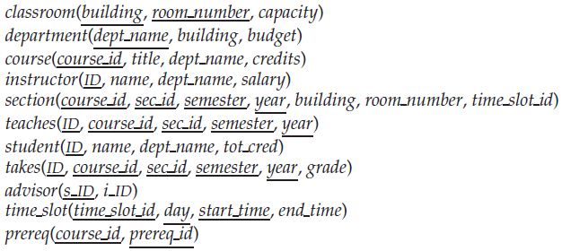
Schema of the University Database
Let’s now create tables for all of the following relations in MySQL
Remember to create and use database before creating the tables
create database university;
use university;

Slide 29
Create Statements
create table classroom
(building varchar(15),
room_number varchar(7),
capacity numeric(4,0),
primary key (building, room_number)
);

Slide 30
Create Statements
create table department
(dept_name varchar(20),
building varchar(15),
budget numeric(12,2) check (budget > 0),
primary key (dept_name)
);

Slide 31
Create Statements
create table course
(course_id varchar(8),
title varchar(50),
dept_name varchar(20),
credits numeric(2,0) check (credits > 0),
primary key (course_id),
foreign key (dept_name) references department (dept_name) on delete set null
);

Slide 32
Create Statements
create table instructor
(ID varchar(5),
name varchar(20) not null,
dept_name varchar(20),
salary numeric(8,2) check (salary > 29000),
primary key (ID),
foreign key (dept_name) references department (dept_name) on delete set null
);

Slide 33
Create Statements
create table section
(course_id varchar(8),
sec_id varchar(8),
semester varchar(6) check (semester in ('Fall', 'Winter', 'Spring', 'Summer')),
year numeric(4,0) check (year > 1701 and year < 2100),
building varchar(15),
room_number varchar(7),
time_slot_id varchar(4),
primary key (course_id, sec_id, semester, year),
foreign key (course_id) references course (course_id) on delete cascade,
foreign key (building, room_number) references classroom (building, room_number) on delete set null
);

Slide 34
Create Statements
create table teaches
(ID varchar(5),
course_id varchar(8),
sec_id varchar(8),
semester varchar(6),
year numeric(4,0),
primary key (ID, course_id, sec_id, semester, year),
foreign key (course_id,sec_id, semester, year) references section (course_id,sec_id, semester, year) on delete cascade,
foreign key (ID) references instructor (ID) on delete cascade
);

Slide 35
Create Statements
create table student
(ID varchar(5),
name varchar(20) not null,
dept_name varchar(20),
tot_cred numeric(3,0) check (tot_cred >= 0),
primary key (ID),
foreign key (dept_name) references department (dept_name) on delete set null
);

Slide 36
Create Statements
create table takes
(ID varchar(5),
course_id varchar(8),
sec_id varchar(8),
semester varchar(6),
year numeric(4,0),
grade varchar(2),
primary key (ID, course_id, sec_id, semester, year),
foreign key (course_id,sec_id, semester, year) references section (course_id,sec_id, semester, year) on delete cascade,
foreign key (ID) references student (ID) on delete cascade
);

Slide 37
Create Statements
create table advisor
(s_ID varchar(5),
i_ID varchar(5),
primary key (s_ID),
foreign key (i_ID) references instructor (ID) on delete set null,
foreign key (s_ID) references student (ID) on delete cascade
);

Slide 38
Create Statements
create table time_slot
(time_slot_id varchar(4),
day varchar(1),
start_hr numeric(2) check (start_hr >= 0 and start_hr < 24),
start_min numeric(2) check (start_min >= 0 and start_min < 60),
end_hr numeric(2) check (end_hr >= 0 and end_hr < 24),
end_min numeric(2) check (end_min >= 0 and end_min < 60),
primary key (time_slot_id, day, start_hr, start_min)
);

Slide 39
Create Statements
create table prereq
(course_id varchar(8),
prereq_id varchar(8),
primary key (course_id, prereq_id),
foreign key (course_id) references course (course_id) on delete cascade,
foreign key (prereq_id) references course (course_id)
);

Slide 40
End of Slides
Notes:
40

